Slide 1

COMP 5350 / 6350 / 6356 Digital Forensics Spring 2019

Slide 2
Project #1

Slide 3
Project #1 Details
Undergraduates
Part 1: 2 images
FAT Image
NTFS Image
Graduates
Part 1: 2 images
FAT Image
NTFS Image
Part 2: $I30 NTFS Attribute
https://digital-forensics.sans.org/blog/2011/09/20/ntfs-i30-index-attributes-evidence-of-deleted-and-overwritten-files
Final Report
Project #1 Due Date: 8 March 2019

Slide 4
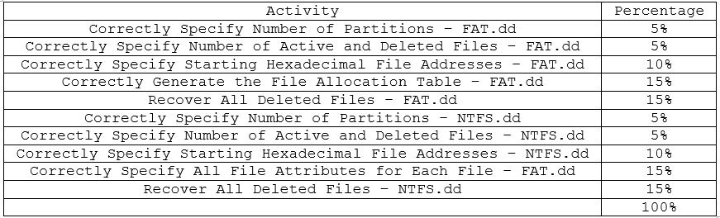
Project #1
Undergraduate Grading Rubric

Slide 5
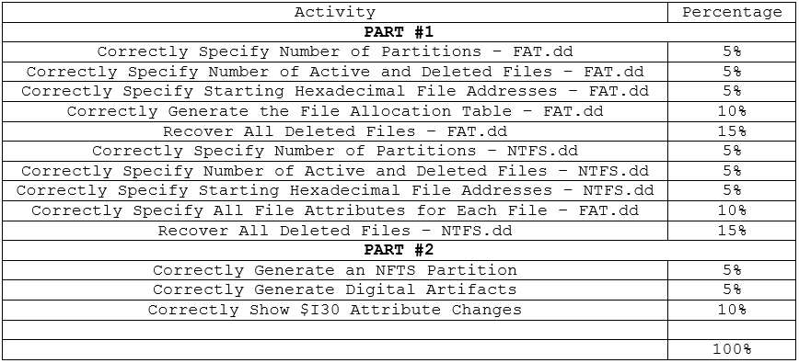
Project #1
Graduate Grading Rubric

Slide 6
Introduction to Hashing Techniques

Slide 7

Digital Forensics Hashing
Unlike a cipher, a cryptographic hash function is a one-way function
When a message is processed through a hashing algorithm it results in a unique set of values that can be checked for message manipulation
A cryptographic hash function is practically impossible to reverse
A hash is also known as a message digest
Plaintext
Hash
Hash
Algorithm
828275c13b4f3a8bd417b5ed00cb962f

Slide 8
Message Digest Algorithm
The message digest algorithm is a hashing function that results in a 128-bit output regardless of the input to the algorithm
Dr. Ronald Rivest was the developer of message digest algorithm and implemented numerous iterations
MD2
18 rounds
MD4
3 rounds
Used in NTLM
MD5
4 rounds
MD6
Variable

Slide 9
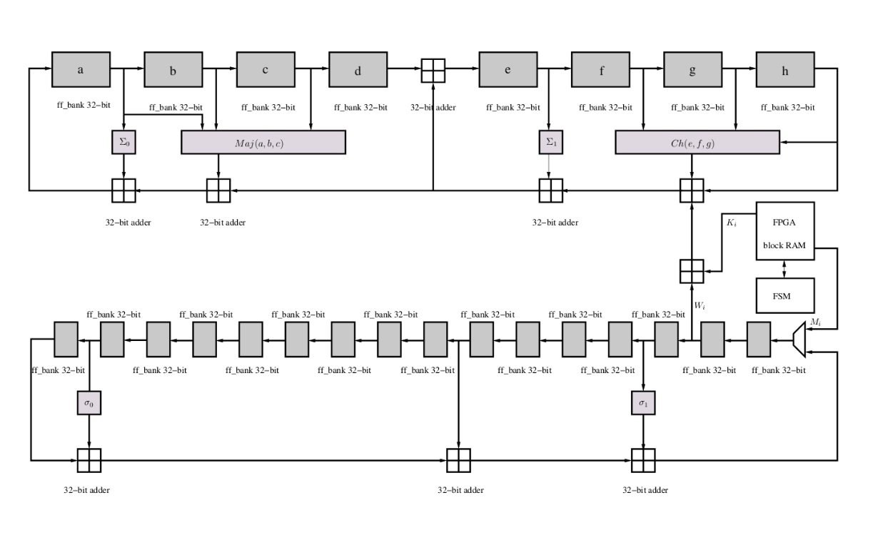
Secure Hashing Algorithm
A hashing algorithm originally designed by the National Security Agency (NSA) and part of the Keccak algorithm
There have been three versions of the SHA
SHA-1
160-bit
SHA-1 is vulnerable to collisions and no longer used
SHA-2
224-bit
256-bit
334-bit
512-bit
SHA-3
Variable

Slide 10


Hash Collisions
The objective of any hashing algorithm is to identify changes to the integrity of a digital object
A collision occurs any time different inputs to a hashing algorithm result in the same hash value
To be of use and to ensure trust, hashing algorithm can not have collisions
From a forensics standpoint, hash collisions undermine the integrity of digital artifacts
Although MD5 and SHA-1 are standard hashing algorithms for numerous applications and are built into most forensics tools, it is recommended to use more secure hashes such as SHA-3
MD5
Hash
828275c13b4f3a8bd417b5ed00cb962f
MD5
Hash
828275c13b4f3a8bd417b5ed00cb962f

Slide 11

sha3sum
There are a number of secure hashing algorithms available with apt or through Github
sudo apt install libdigest-sha3-perl
sha3sum defaults at 224-bit output
To increase output size:
sha3sum --algorithm 512 FILENAME

Slide 12
Rainbow Tables
Many operating systems utilized hash-based security for credentials
If a system is compromised, it is relatively easy to gain access to credentials for follow-on system access
Rainbow tables provide a precomputed hash database to test exploited hashes
There are a wide variety of online databases and offline GPU tools to crack hashes
To make it more difficult to calculate hashes directly, additional characters known as a “salt” are added prior to hashing

Slide 13
Disk Partitions vs. NTFS Partitions

Slide 14
Disk Partition vs. NTFS Partition
When creating a single NTFS partition on a device, the start of the NTFS partition is not at the start of the device partition
There is generally an offset used to buffer the disk partition from the NTFS partition
An example of this is the default value of 2048 used to start an NTFS partition
Disk Partition – Sectors 0 - 2047
Disk Boot Sector
Disk Data Area
NTFS Partition – Sectors 2048 – Last Sector
Master Boot Record
Master File Table
File Data
Master File Table Backup
Last
Sector
/dev/sdb
2048
Disk
Boot
Sector
Disk
Data
Area
Master
Boot
Record
Master
File
Table
File
Data
Area
Master
File
Table
Backup
0
2047
/dev/sdb1

Slide 15
NTFS Data Recovery Process

Slide 16
NTFS Data Recovery Process
When dealing with NTFS File Systems and attempting to recover data the following steps will help to organize the recovery process:
Create a Proper Media Image
Analyze Partition Header
Analyze NTFS Partition Header
Analyze File Header
Classify Files as Existing or Deleted
Classify Files as Resident or Non-Resident
Locate File Contents
Recover File Contents

Slide 17
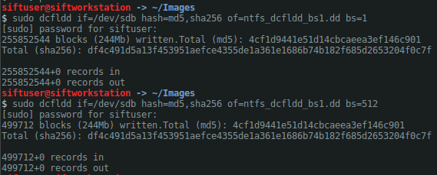
Create a Proper Media Image
Identify the media for imaging
Select and test write blocker
Collect image
Hash image

Slide 18
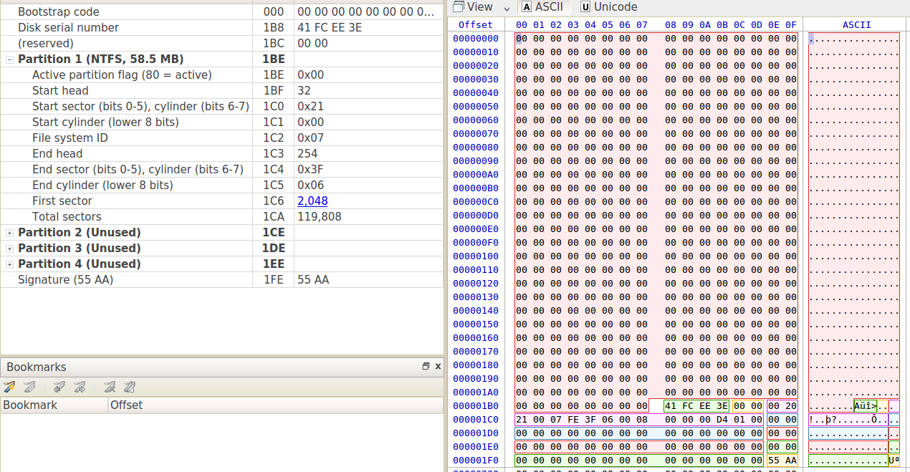
Analyze Partition Header
Partition Type: 0x07 – NTFS
First Sector Location: 0x0800
Sector Size: 512 -> 0x0200

Slide 19
Calculate Start Address of NTFS Partition
First Sector Location: 0x0800
Sector Size: 512 -> 0x0200
0x0800
0x0200
0x100000
The NTFS Partition starts at address 0x100000

Slide 20
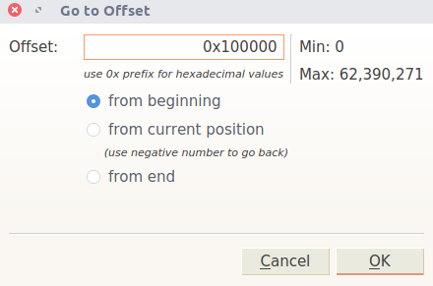
Move to Start Address of NTFS Partition
The NTFS Partition starts at address 0x100000

Slide 21
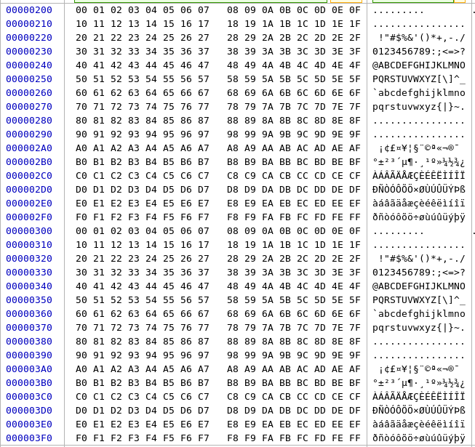
Empty Sectors in Disk Partition

Slide 22
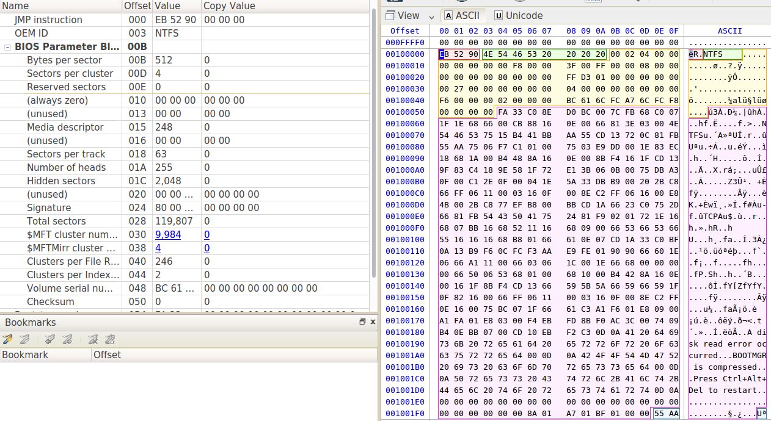
Analyze NTFS Partition Header
Bytes / Sector = 512
Sectors / Cluster = 4
2048 Bytes / Cluster
$MFT Cluster: 0x2700

Slide 23
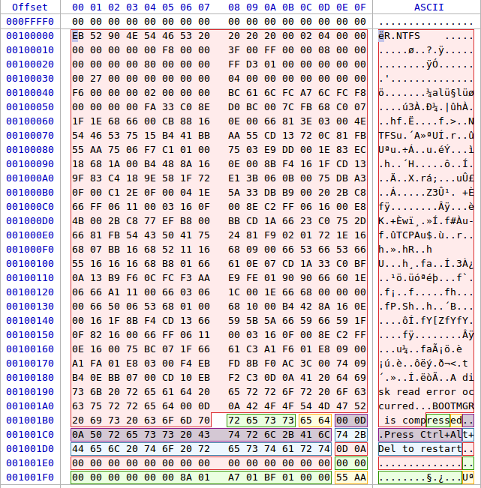
Calculate Start Address $MFT
The $MFT start address is from start of the disk partition!
Bytes / Sector = 512
Sectors / Cluster = 4
2048 Bytes / Cluster
$MFT Cluster: 0x2700
0x2700
0x0800
0x1380000
0x0100000
0x1480000
$MFT starts at address 0x1480000

Slide 24
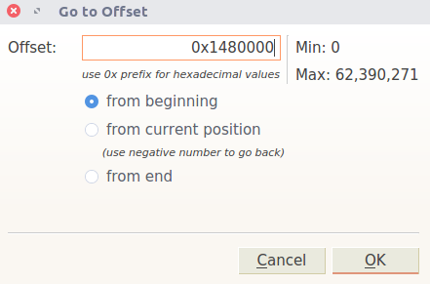
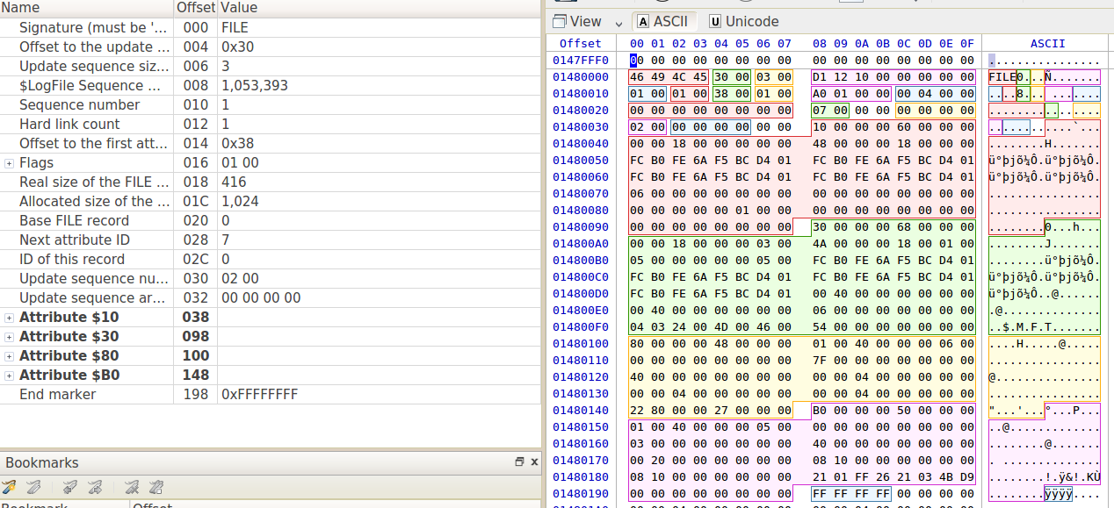
Move to Start Address of NTFS Partition
$MFT starts at address 0x1480000

Slide 25
$MFT Attribute Headers
$STANDARD_INFORMATION
0x00000010
$FILE_NAME
0x00000030
$DATA
0x00000080
$BITMAP
0x00000080

Slide 26
$MFT Attribute Header Lengths
$STANDARD_INFORMATION
0x00000060
96 bytes
$FILE_NAME
0x00000068
104 bytes
$DATA
0x00000048
72 bytes
$BITMAP
0x00000050
80 bytes

Slide 27
$MFT Considerations
The information provided in the MFT provides everything necessary to rebuild digital artifacts in an NFTS file system
MFT Facts
Each MFT entry is 1024 bytes
The first 39 MFT file entries are system generated
$MFT starts at entry 0
WPSettings.dat ends at entry 38
The 39th entry of the MFT table is the start of user generated data

Slide 28
MFT System Files
MFT System Files:
$MFT – 0
$MFTMirr – 1
$LogFile - 2
$Volume - 3
$AttrDef - 4
$I30 - 5
$Bitmap - 6
$Boot - 7
$BadClus - 8
$Secure - 9
$UpCase - 10
$Extend – 11
$MFT Extensions - Reserved – 12-23
$Extend\$Quota – 24
$Extend\$ObjId – 25
$Extend\$Reparse - 26

Slide 29
MFT System Files (con’t)
MFT System Files:
$RMMetadata – 27
$Repair – 28
$Deleted - 29
$TxtLog - 30
$Txf - 31
$Tops - 32
$TxfLog - 33
$TxfLogContainer1 - 34
$TxfLogContainer2 - 35
System Volume Information - 36
Indexer Volume GUID - 37
WPSettings.dat – 38

Slide 30
MFT System File Definitions
Descriptions of each of the MFT system files:
$MFT
MFT Entry 0
Provides definitions for all files on the partition
$MFT has a unique attribute called $BITMAP which is used to manage MFT entries
$MFTMirr
MFT Entry 1
Backup of the 1st 4 $MFT entries
$LogFile
MFT Entry 2
Used as the NTFS journal which tracks changes to system metadata
$Volume
MFT Entry 3
Contains information specific to the partition including volume label, volume identifier, file system version, and volume flags

Slide 31
MFT System File Definitions
Descriptions of each of the MFT system files:
$AttrDef
MFT Entry 4
Tracks all file system attribute names and identifiers
$I30
MFT Entry 5
Also known as the root directory
A key file for recovering deleted and overwritten data in NTFS
$Bitmap
MFT Entry 6
Tracks cluster utilization
$Boot
MFT Entry 7
Contains the boot sector and boot code in its $DATA attribute
$Boot always starts in sector 0
$Boot is the only file that cannot be relocated

Slide 32
MFT System File Definitions
Descriptions of each of the MFT system files:
$BadClus
MFT Entry 8
Lists all bad clusters in the partition
$Secure
MFT Entry 9
Contains all security descriptors for all files on the partition
$UpCase
MFT Entry 10
Converts lowercase characters to matching Unicode uppercase characters
The purpose is to provide proper formatting for optional extensions including quotas, reparse point data, and identifiers
$Extend
MFT Entry 11
Extended data to aid with disk quotas, reparse point data, and identifiers

Slide 33
MFT System File Definitions
Descriptions of each of the MFT system files:
$Extend\$Quota
MFT Entry 24
Contains user assigned quota limits on the volume space
$Extend\$ObjId
MFT Entry 25
Contains all file object identification numbers
$Extend\$Reparse
MFT Entry 26
Contains information about files and folders on the volume include reparse point data

Slide 34
Data Recovery Examples System Generated Data

Slide 35
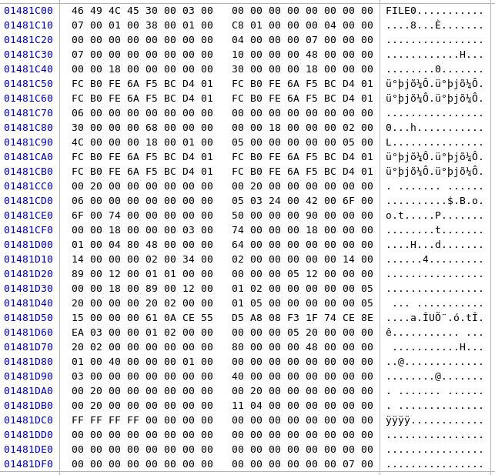
$Boot Entry Attributes and Sizes
$SI
0x48 -> 72 bytes
$FN
0x68 -> 104 bytes
$SD
0x90 -> 144 bytes
$DATA
0x48 -> 72 bytes

Slide 36
$Boot Entry $DATA Attribute
The $DATA attribute of the $Boot entry in the MFT defines many of the details of the NTFS MBR
0x01 – Non-Resident Data
0x0040 – 64 bytes from the start of $DATA is where to find information relative to boot code location
File size
0x2000
0x1104
0x00
Start cluster
for boot code
1 – The first cluster address requires one byte
1 – The number of continuous clusters for the file – 1*4

Slide 37
$Boot Entry $DATA Attribute
The $DATA attribute of the $Boot entry in the MFT defines many of the details of the NTFS MBR
0x01 – Non-Resident Data
0x0040 – 64 bytes from the start of $DATA is where to find information relative to boot code location
File size
0x2000
0x1104
0x00
Start cluster
for boot code
1 – The first cluster address requires one byte
1 – The number of continuous clusters for the file – 1*4

Slide 38
Data Recovery Example #1 User Generated Data

Slide 39
User Generated Data
Based on what we have shown so far, we know the following information about NTFS partitions
Location of NTFS boot sector
Location of the MFT
The number of system level MFT entries
The starting point of user generated data
The location of file contents from the $DATA attribute
The size and location of files contents from the $DATA attribute
Whether data is resident or non-resident

Slide 40
Finding User Generated Data
Let’s apply what we know so far about the example partition:
Location of the partition boot sector
0x00000000
Location of NTFS boot sector
0x00100000
Location of the MFT
0x01480000
The number of system level MFT entries
39
We know that each MFT entry is 1024 bytes
So from the start of MFT, we must add 9C00
39 * 1024 = 39,936
39,936 => 9C00
0x01480000 + 0x9C00 = 0x01489C00

Slide 41
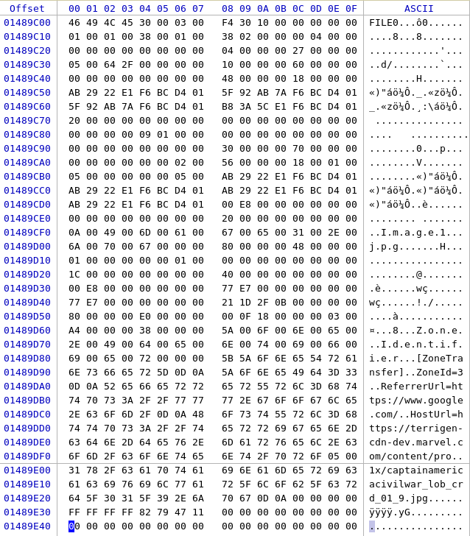
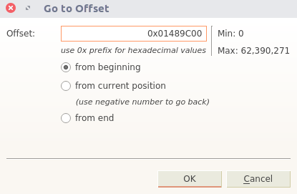
Finding User Generated Data
0x01480000 + 0x9C00 = 0x01489C00

Slide 42
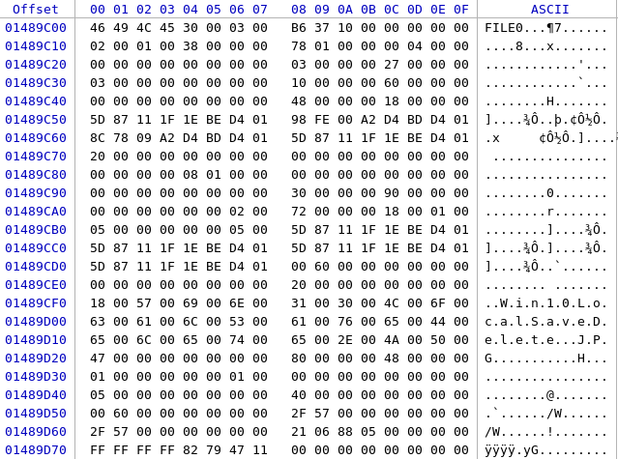
Finding User Generated Data
$SI
0x60 -> 96 bytes
$FN
0x90 -> 144 bytes
$DATA
0x48 -> 72 bytes

Slide 43
User Generated Data - $DATA Attribute
$DATA provides us with all details regarding file contents
Non-Resident Data
0x01
Deleted File
0x0000
64 bytes from the start of $DATA is where to find information about where the file resides in storage
0x0040
The disk space used for the file is 24,576 bytes
0x6000
The size of the file is 22,319 bytes
0x572F
The first cluster address requires 2 bytes and the file takes up 6 continuous clusters (1 * 0x06 = 6)
0x2106
The starting cluster for the file contents
0x0588

Slide 44
User Generated Data - $DATA Attribute
Knowing both the starting address of the cluster chain and the number of clusters needed to store the file, we can now recover the file:
The starting cluster of the file
0x0588
The disk space used for the file is 24,576 bytes
0x6000
Recall: 1 cluster is 8 sectors, 4096 bytes - 0x1000
Recall: NTFS partition starts at address 0x100000
Combining each of these elements, we can now find the starting address of the file contents:
0x0588 * 0x1000 = 0x588000
0x588000 + 0x100000 = 0x688000
Now calculate the last address of the file contents
0x688000 + 0x6000 = 0x68E000

Slide 45
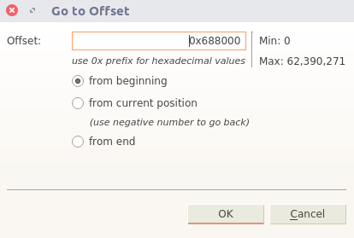
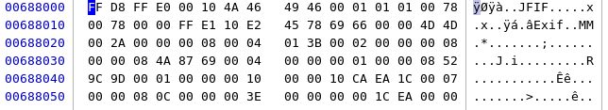
Display User Generated Data
Starting Address: 0x688000
Ending Address: 0x68E000

Slide 46
Magic Numbers
Depending on operating system implementation, files can be appended with extensions based on their application
Most applications that utilize this method of tracking files encode them with specific values to specify which application is being used to read those files
Magic number is a term used to describe the value appended to the header of file to define which application that file can be read by
Some common magic number values:
DOCX, PPTX, XLSX
0x504B030414000600
JPG
0xFFD8
MOV
0x6D6F6F76

Slide 47
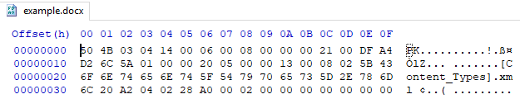

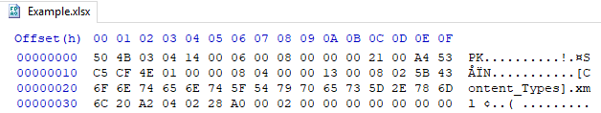

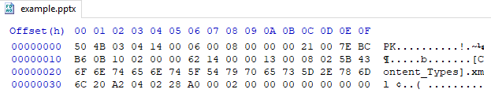
Magic Numbers – MS Office
Examples of different MS Office artifacts

Slide 48
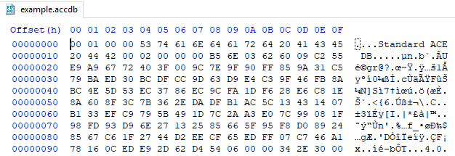
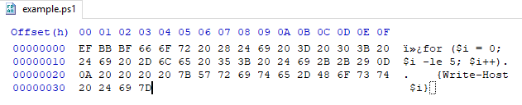
Magic Numbers – Database & Script
Magic numbers for different database and script applications

Slide 49

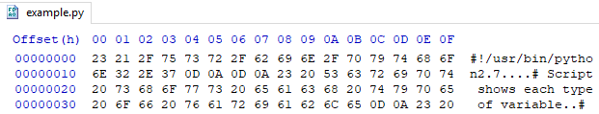
Magic Numbers – Flat Files
A hex editor can be used to quickly identify magic numbers

Slide 50
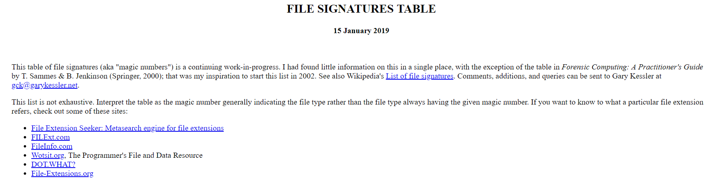
Magic Numbers References
There are a number of key online resources that should be used during data recovery efforts
The best resources include:
Kessler’s File Signature Table
Forensic Computing: A Practitioner's Guide
https://www.garykessler.net/library/file_sigs.html

Slide 51
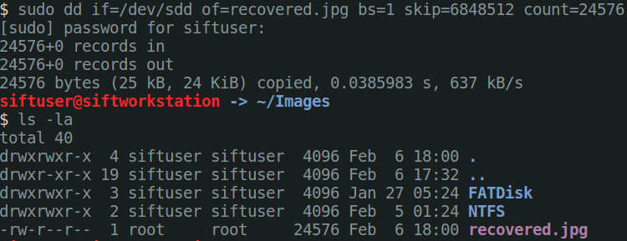
Rebuild the File
Starting Address: 0x688000, Ending Address: 0x68E000
0x688000 => 6,848,512 bytes
File size is 24,576 bytes
From the file header we think the file is jpg
0xFFD8
Rebuild the file
sudo dd if=/dev/sdd of=recovered.jpg bs=1 skip=6848512 count=24576

Slide 52
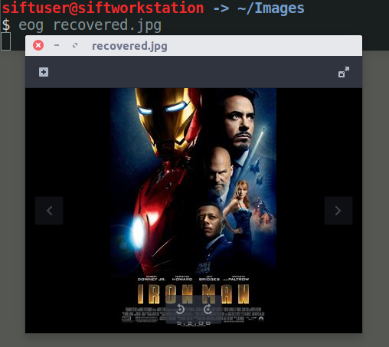
View the File

Slide 53
Data Recovery Example #2 User Generated Data

Slide 54
Template
Disk Partition Information
1) Sector Size = ? bytes = 0x?
2) First Sector = 0x?
3) First Sector Address: 1 * 2 = 0x?
NTFS Disk Partition Information
4) Bytes/Sector = 0x?
5) Sectors/Cluster = 0x?
6) Bytes/Cluster = 5 * 6 = ? Bytes = 0x?
7) $MFT Start Cluster: 0x? * 6 + 3 = 0x?
MFT Information
8) MFT Entry Size = 1024
9) Number of System Files = 39 (check)
10) MFT System Files Length: 1024 * 39 = 0x9C00
11) Start of User Files: 7 + 0x9C00 = 0x?
User File Information
12) List File Attributes: 0x10 - $STANDARD_INFORMATION, 0x30 - $FILE_NAME, 0x80 - $DATA
13) Filename = XXXX.XXX
14) File Size = 0x? = ? bytes
15) Data Start Cluster: 0x? * 6 + 3 = 0x? = ? bytes
sudo dd if=/dev/sdX of=<13> bs=1 skip=<15> count=<14>

Slide 55
Homework
Read SANS blog on utilization of $I30 attribute to recover deleted and overwritten files
https://digital-forensics.sans.org/blog/2011/09/20/ntfs-i30-index-attributes-evidence-of-deleted-and-overwritten-files

Slide 56
References
NTFS Structures
File System Forensic Analysis, Carrier, Chapters 11 – 13
NTFS System Files
http://www.ntfs.com/ntfs-system-files.htm

